Slide 1
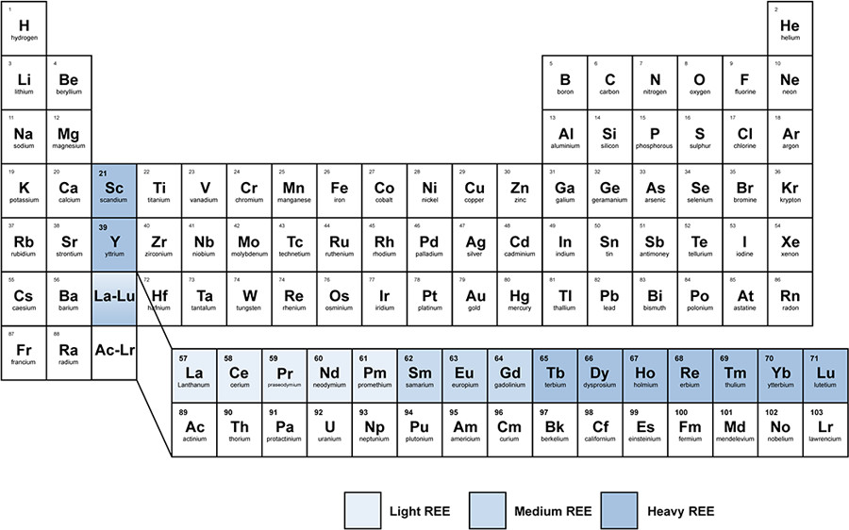
DOI: (10.1021/sc500573b)

Slide 2
ACS Sustainable Chem. Eng. 2015, 3, 2, 237-244

